Slide 1
Direct Connection to a Raspberry Pi
From:
https://desertbot.io/blog/headless-pi-zero-ssh-access-over-usb-windows

Slide 2
Introductory Note
Connecting to a Raspberry Pi 3 or 4 is quite a bit different from connecting to a Pi Zero.
You don't need to make as many changes to the microSD card, but you need two cables, one for power and the other for data.

Slide 3
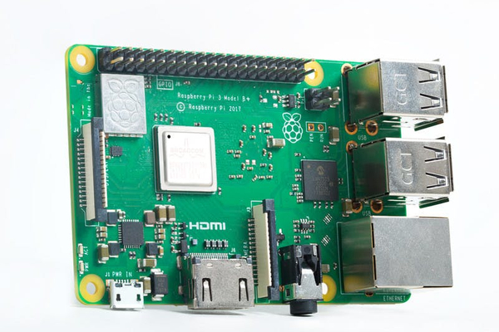
A Rasberry Pi 3 B+

Slide 4
How to Access a Raspberry Pi 3 B+
When you first get a Pi, the big question is -- how do you access it? You can get a USB keyboard, USB mouse and HDMI adapter. Or you can just plug it into your computer directly and access it over ethernet using ssh.
This presentation shows you how to do the last option.

Slide 5
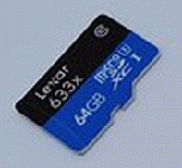
Hardware Needed
MicroSD card, with an SD card adapter.
A computer with an SD card slot.
A microUSB cable (to power a Raspberry Pi 3)
or a USB-C cable (to power a Raspberry Pi 4)
An ethernet cable
(This will connect the Pi to the computer.)

Slide 6
Software Tools Needed
Raspbian Lite, found at www.raspberrypi.org/downloads/.
balenaEtcher, found at www.balena.io/etcher/
(For Windows computers)
Bonjour Print Services, found at support.apple.com/kb/DL999?locale=en_US

Slide 7
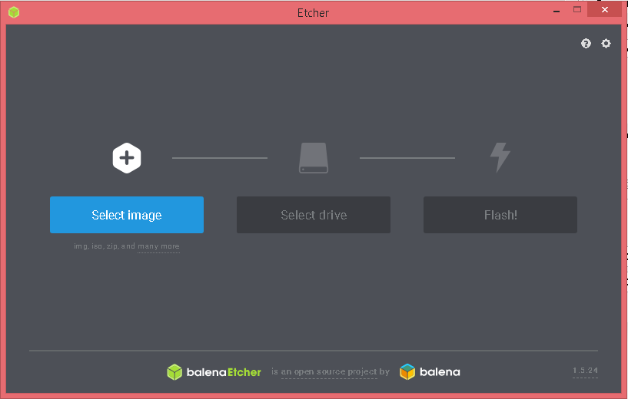
Installing Raspbian Lite
Put the SD card into an adapter and plug it into your computer
Run Etcher and select the Raspbian zip file
Select the SD card drive
Finally, click Flash to write the Raspbian image to the SD card
You'll see a progress bar. Once complete, the utility will automatically unmount the SD card.

Slide 8
Editing the Raspbian Lite Image
Pull the SD card out and plug it back in again
The SD card should appear in Finder as a drive named "boot"
Open the SD card and explore the contents in File Explorer
You should now see the contents of the root of your Raspbian boot image

Slide 9
Enable ssh
To enable ssh by default you have to place an empty filed named ssh. (no extension) in the root of the card.
Run TextEdit on MacOS.
In a new file put in one space and nothing more
Call the file ssh and save it to the root of the MicroSD card.

Slide 10
Connecting to a Windows Computer
You will need to install Bonjour Print Services so that you can connect to the Raspberry Pi without knowing its IP address.

Slide 11
Boot the Pi
Eject the MicroSD card from the main computer, and put it into the Pi card slot.
Plug the ethernet cable into the ethernet port on the main computer. If you do not have an ethernet port, you will need an adapter, either USB-Ethernet (Windows computer) or Thunderbolt-Ethernet adapter (MacOS computer).
Plug the Micro-USB or USB-C cable into the power port on the Pi.
Plug the other end into a USB port on your computer
The red light on the Pi will start blinking. Wait several seconds after it stops blinking.

Slide 12
Login Over USB Using SSH
On a Mac, just open a terminal screen, and type:
ssh pi@raspberrypi.local
Enter the password (raspberry) and you will be good to go!

Slide 13
Login Over USB Using SSH
Open a Command Prompt (Windows computer) or Terminal (Mac computer), and type:
ssh pi@raspberrypi.local
Enter the password (raspberry) and you will be good to go!

